Slide 1

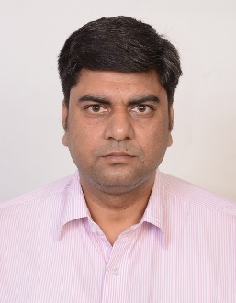



Sumeet Garg
Experience Summary
15
years of experience in Automation testing, QA and project management as PMP certified Project Manager for large multinational product or IT service providers
Expertise
Automation Testing with Selenium+TestNG+Cucumber, SilkTest,RFT, QTP, RestAssure,POSTMAN and SOAP UI.
Worked on different automation frameworks Page Object Model, Data-driven, Hybrid, Keyword
Web services testing using SOAP UI, POSTMAN and Rest Assure .
Devops tools Git,GitHub,Jenkins,SonarQube and Docker.
Good Understanding on C, C++ and Java.
Test estimation/scheduling, Test strategy, Test planning, Project Management
Devop,Agile-Scrum and Waterfall methodology
Resource hiring, mentoring and team Building, motivational skills.
Risk Mitigation and planning
Excellent communication
Automation Expert
Technical & Domain Skills
Software Automation
Framework Design
Selenium, RFT, QTP
REST and SOAP Web services Testing
DevOps
Project Management
Recent Achievements
Planned and executed transition of application from old vendor to TechMahindra
For AT&T client , Introduced and completed automation using selenium and TestNG without missing SLAs.
Achieved all automation goals by better Planning and effective metrics for AT&T.
Reported Defect Reports promptly and thoroughly for defects resolutions & enhancements by using DevOps CI/CD pipelines
Partnering with the Project Management Office, Business team, Development Team, and Third-Party Vendors to ensure that the testing strategy is understood, in use, test prerequisites are completed, and that test outputs are analysed.
Certifications
sg0017473@techmahindra.com
+91 98159-83463

